Slide 1
Bias Check and mitigate in Hiring Final Presentation
Donghuai Li, Guanting Gai
Yichen Zhang, Kehan Wang, Yue Wang,
05-2020

Slide 2
Contents
Retrospect
Interaction of Bias Factors
Python Packages
-FairML
-Fairlearn
-AI Fairness 360
4. Other General Ways
5. Conclusion & Future Work

Slide 3
Retrospect
Objective
Select right candidates: top 80%
Fairness among different groups: Gender, Age, Race

Slide 4
Retrospect
Recap what we have already done:
Determine the definition of fairness and related metrics
Chi Square test: recommendation rates of different groups are same
Four-Fifth rules: recommendation rates of disadvantage group is not less than four-fifths (80%) of advantage group

Slide 5
Retrospect
Recap what we have already done:
Build a linear regression model and make the prediction
Personality
Step1:
Small dataset
Model
EDA
Rating
Bias Factors
Personality
Model
Predicted Rating
Step2:
Big dataset
Bias Factors

Slide 6
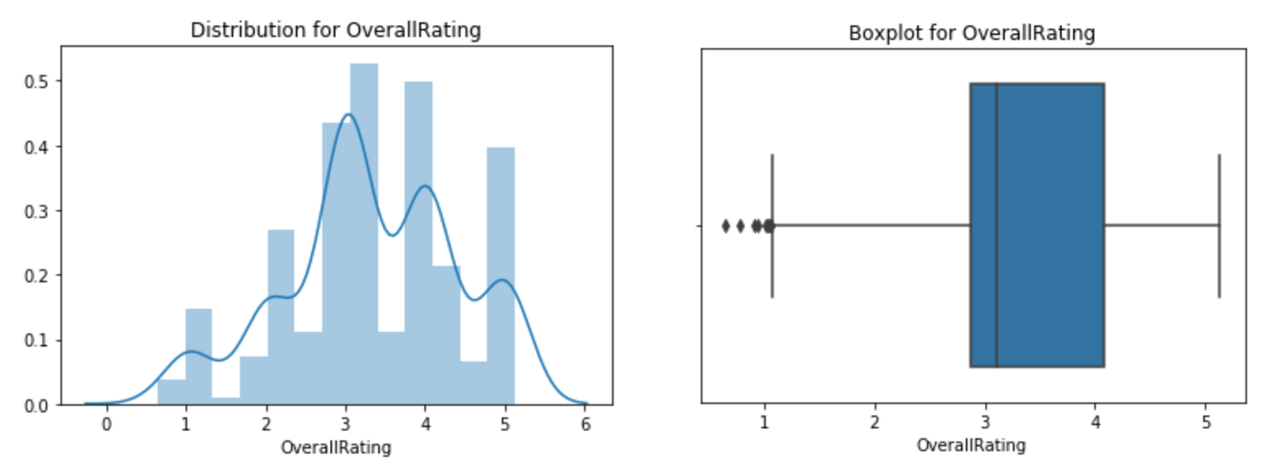
Retrospect
OverallRating

Slide 7
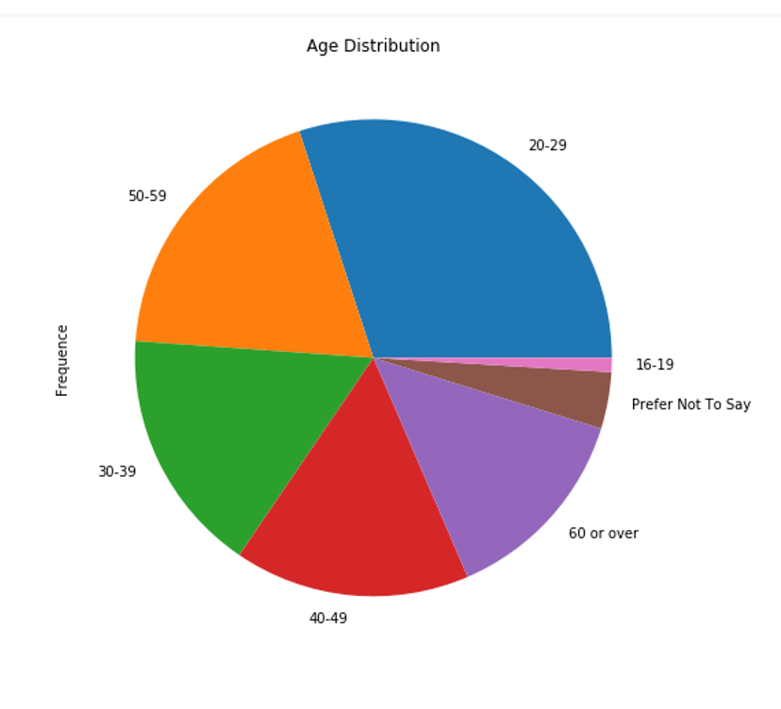
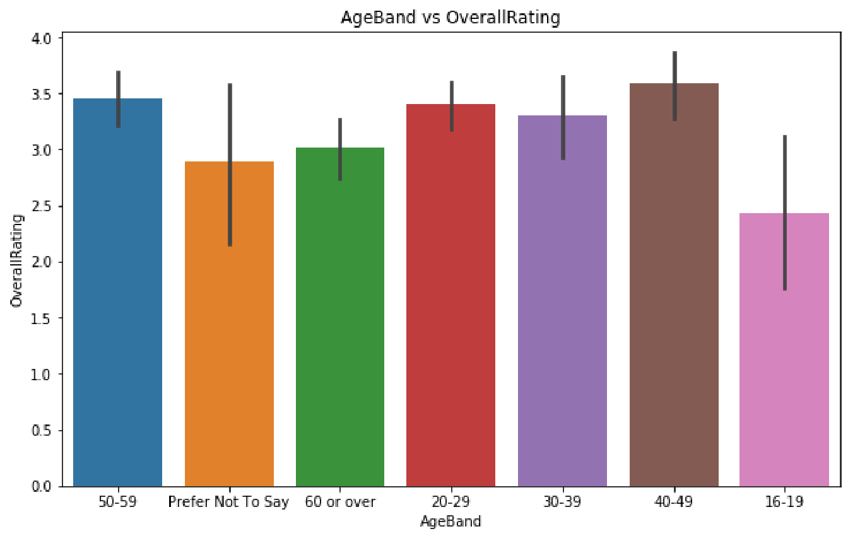
Retrospect
OverallRating & Age

Slide 8
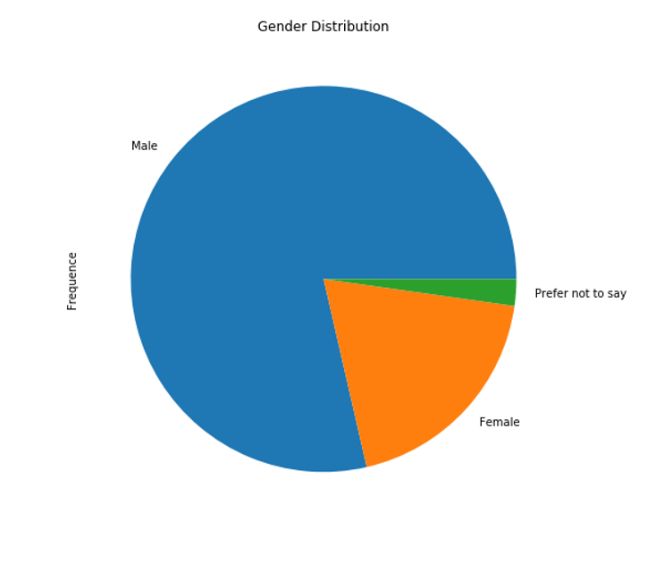
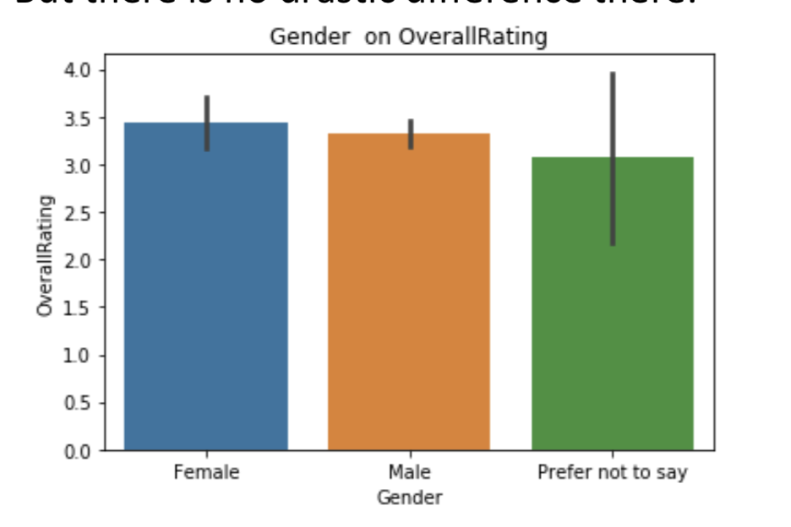
Retrospect
OverallRating & Gender

Slide 9
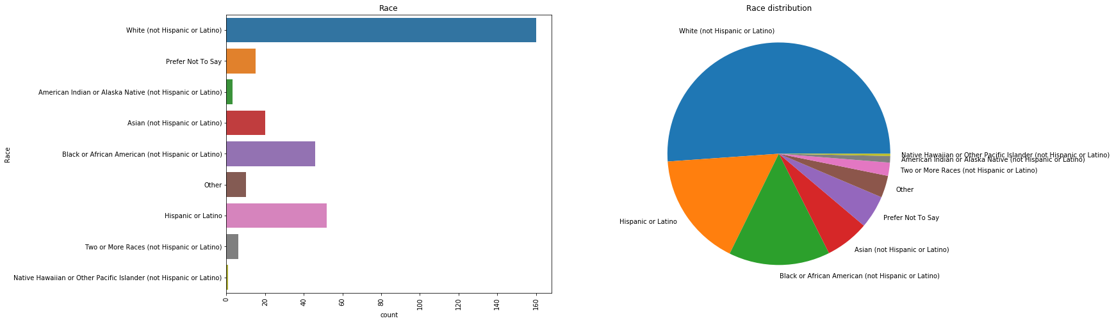
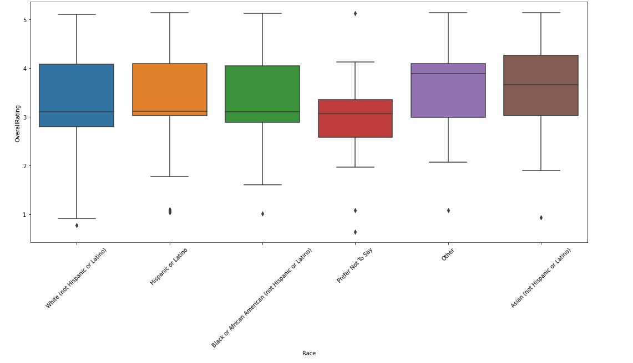
Retrospect
OverallRating & Race

Slide 10
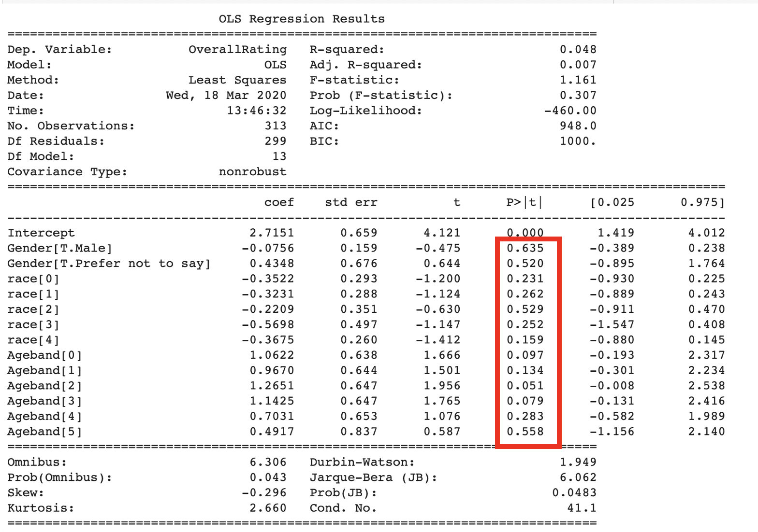
Retrospect
First step
Use existing OverallRating with (Age, Gender, Race)
- whether there’s bias in current supervisor’s impressions
-All the independent variables are not significantly correlated with “OverallRating”
- No bias

Slide 11
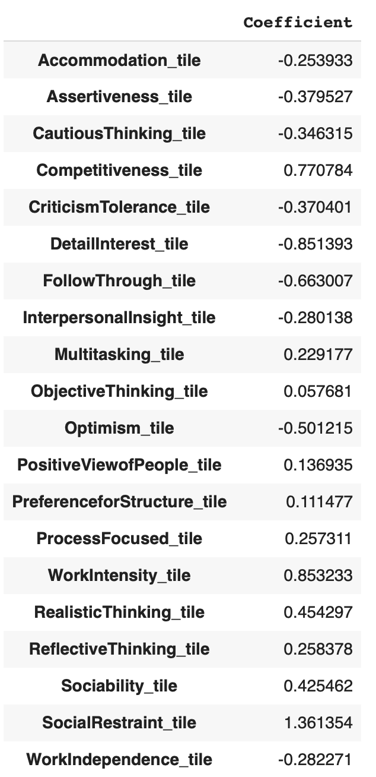
Retrospect
Baseline Model
Dependent variable: overallrating
independent vairables( features): characteristcs
So we can have prediction overallrating for employees.
Baseline Model Performance
R^2: 0.2

Slide 12
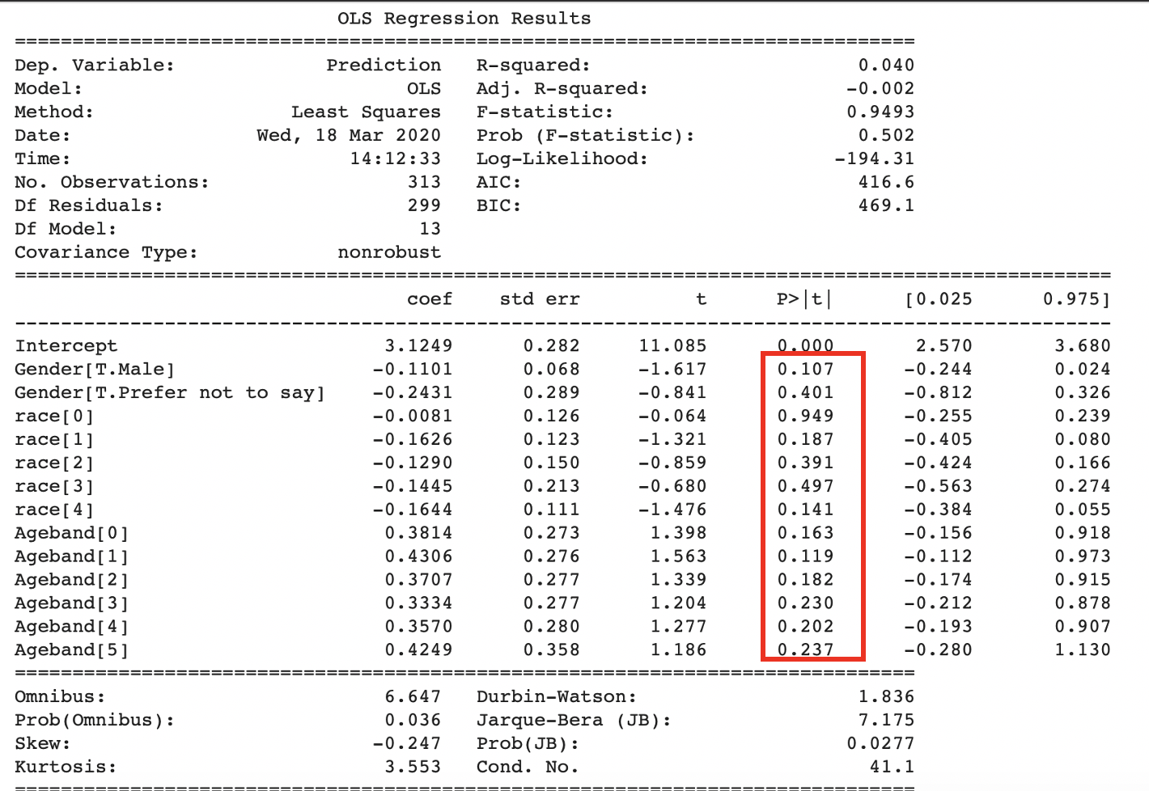
Retrospect
Baseline Model: Linear Regression
Use linear Regression to predict OverallRating
Use prediction OverallRating with (Age, Gender, Race)
- whether there’s bias in prediction rating in our own model result
- No bias

Slide 13
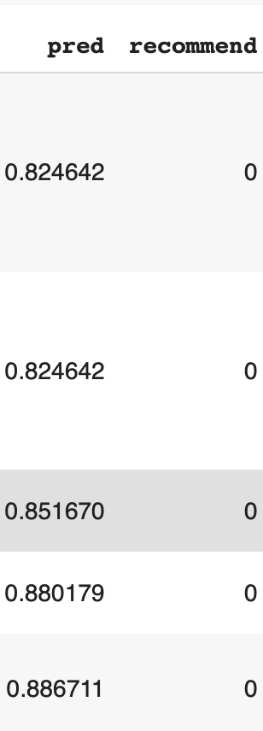
Retrospect
Create recommendation criteria
calculate the prediction OverallRating( same model as before)
Sort the prediction OverallRating from low to high, selected top 80% as recommended, the bottom 20% as not recommended
eg. predicition 5.54 >- recommended >- assign to 1
prediction 0.82 >- not recommended >- assign to 0

Slide 14
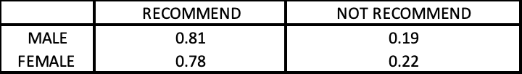
Retrospect
Recap what we have already done:
Recommendation rate in different groups(Gender, Age, Race)
According to the Chi Square test: biased
According to the Four-Fifth rules: unbiased

Slide 15
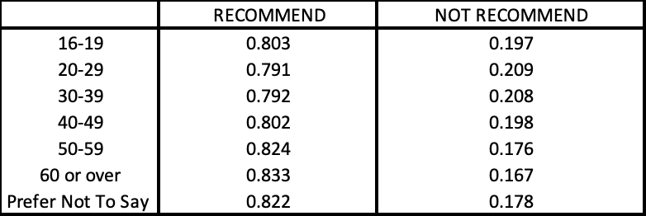
Retrospect
Recap what we have already done:
Recommendation rate in different groups(Gender, Age, Race)
According to the Chi Square test: biased
According to the Four-Fifth rules: unbiased

Slide 16
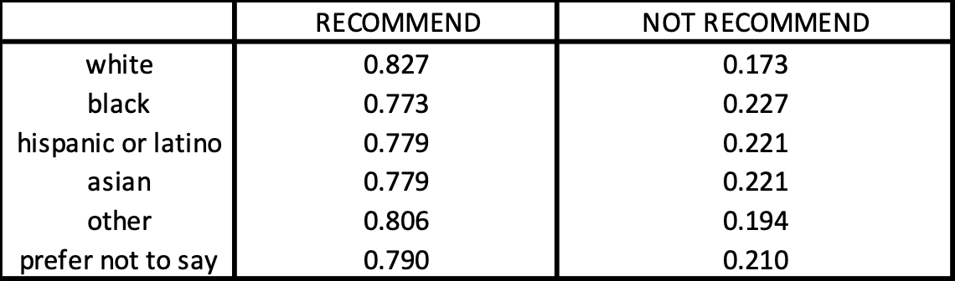
Retrospect
Recap what we have already done:
Recommendation rate in different groups(Gender, Age, Race)
According to the Chi Square test: biased
According to the Four-Fifth rules: unbiased

Slide 17
Retrospect
Activities since last meeting:
Interaction of different bias factors
not only male or female
young male and old female
Use python packages to find and address bias
FairML
Fairlearn
AI Fairness 360

Slide 18
Interaction
Interactions
Bias between two factors
Bias among three factors

Slide 19
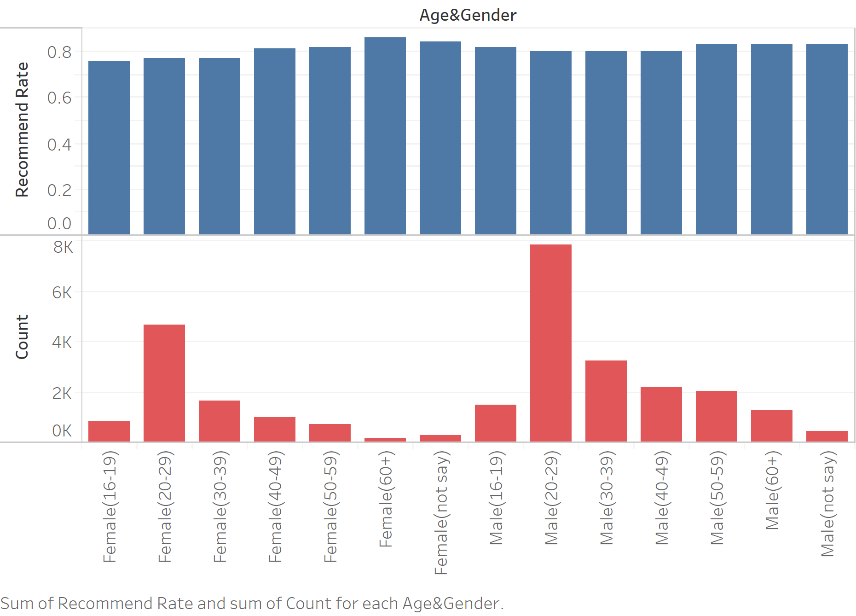
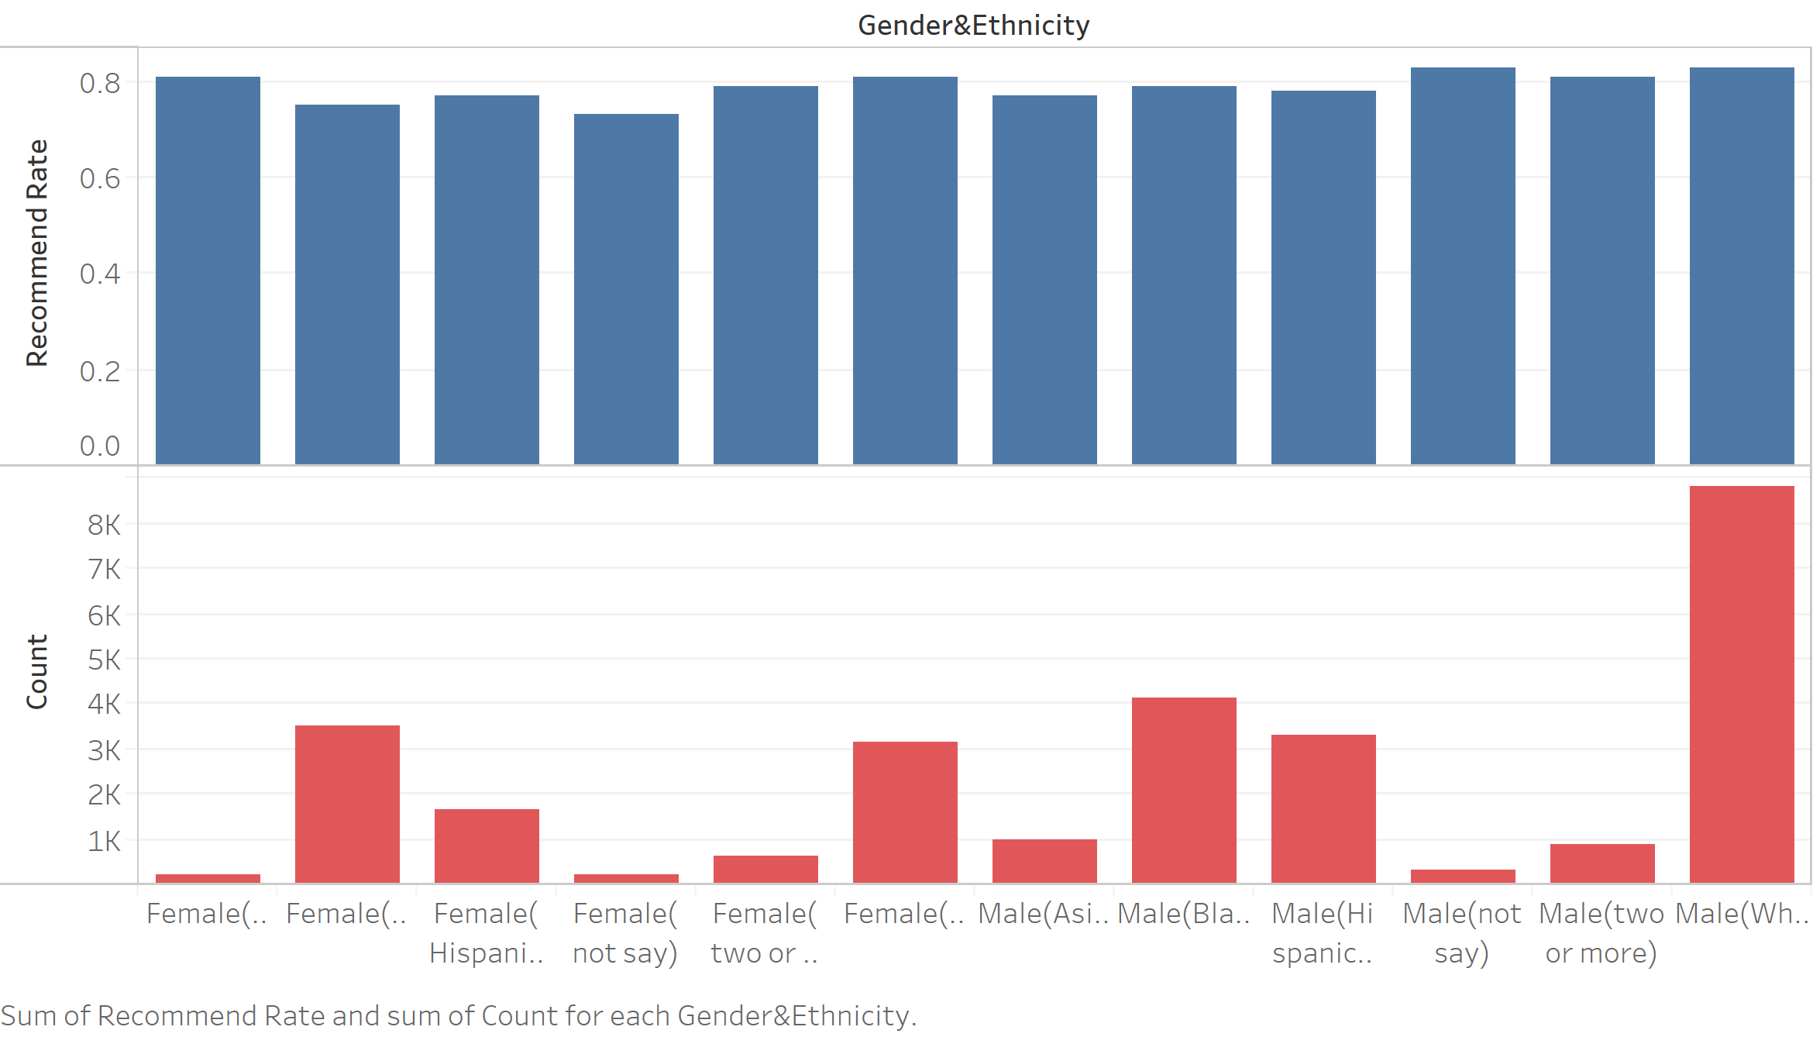
Interaction
Age&Gender/Race&Gender:
No bias(Fifth-Fourth Rule)

Slide 20
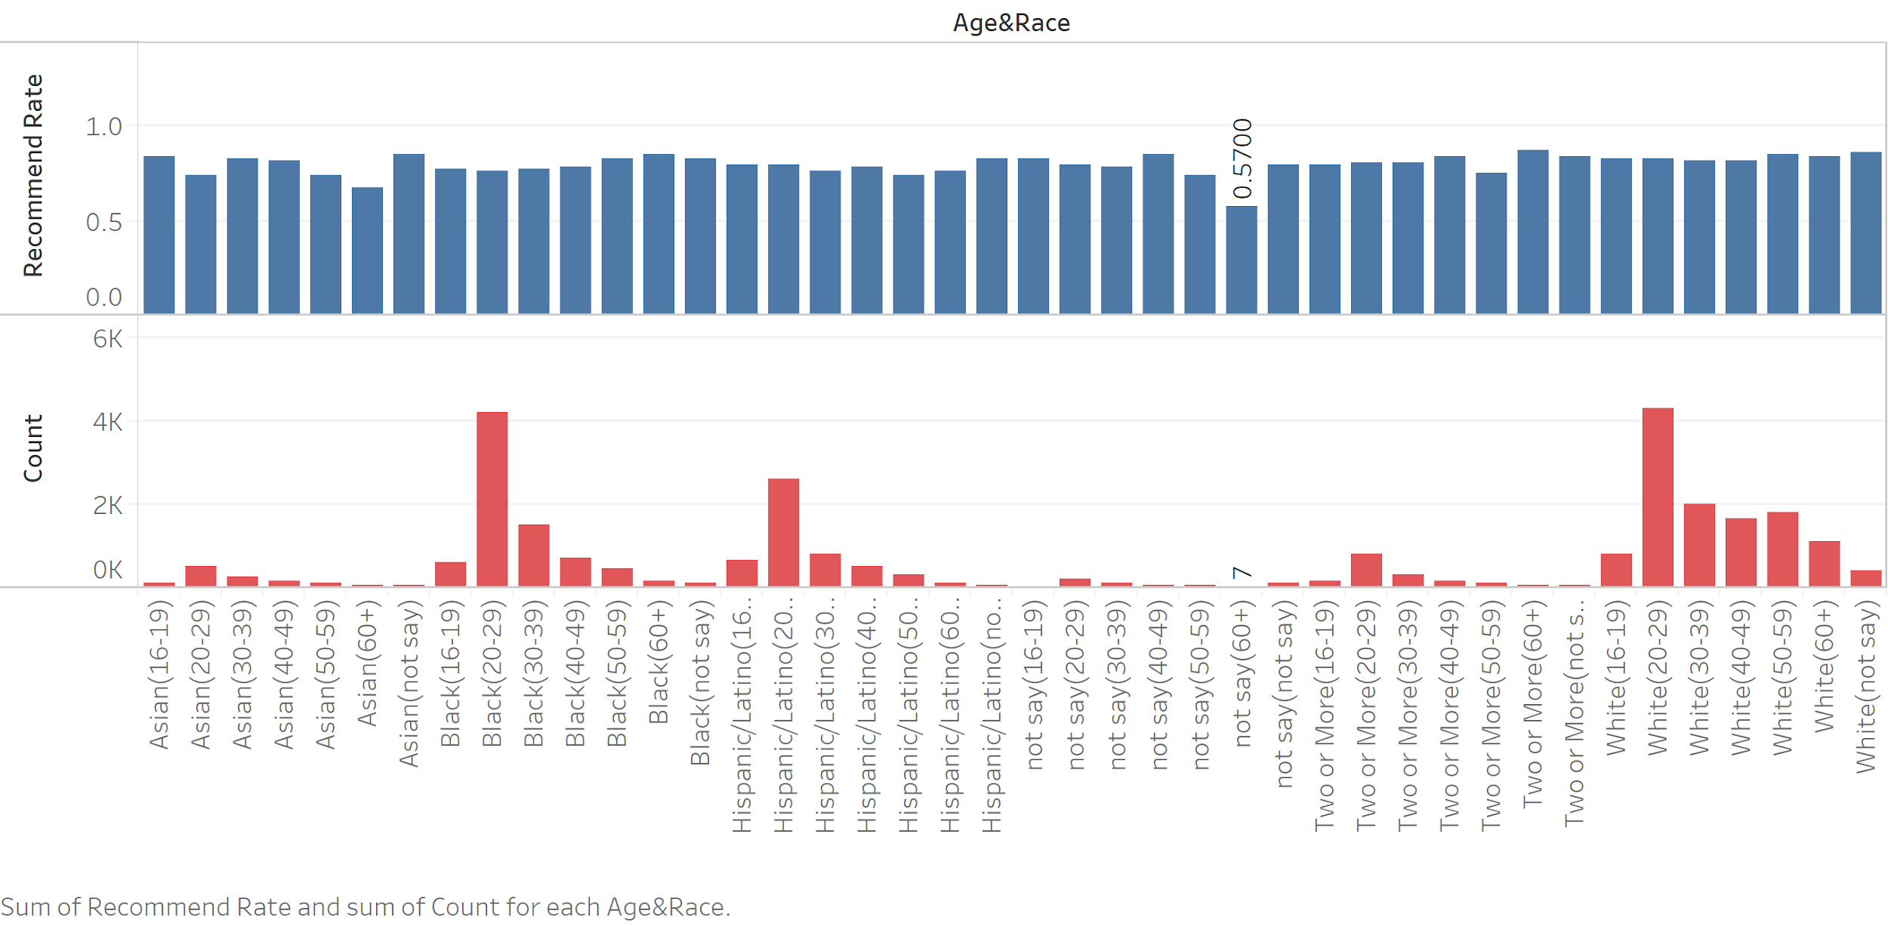
Interaction
Due to small dataset
Age&Race: No bias

Slide 21
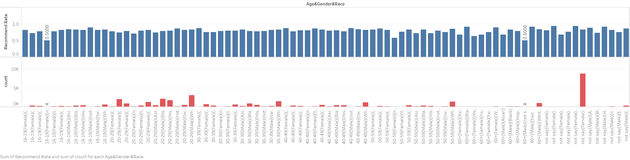
Interaction
Due to small dataset
Age&Race&Gender: No bias

Slide 22
Packages- Fairlearn
Fairlearn: A package created by Microsoft to find and reduce bias
It contains two parts:A dashboard to assess which groups are negatively impacted by a model, and for comparing multiple models in terms of various fairness and accuracy metrics and the Algorithms to reduce bias.
There is an illustration of the dashboard:
https://colab.research.google.com/drive/12MQclXsmwyqv2jHsUP6wwVcm_JsDt8iW
(the dashboard only works in Jupyter Notebook)

Slide 23
Packages- Fairlearn
Fairlearn: A package created by Microsoft to find and reduce bias
The basic idea of the algorithm is to generate several models that achieve various trade-offs between accuracy (measured by AUC) and disparity.This algorithm comes from the paper "A Reduction Approach to Fair Classification" (Agarwal et al. 2018). (https://arxiv.org/abs/1803.02453 )
The key idea is to reduce fair classification to a sequence of cost-sensitive classification problems, whose solutions yield a randomized classifier with the lowest (empirical) error subject to the desired constraints.
An illustration of trade off between accuracy and disparity:
https://colab.research.google.com/drive/12MQclXsmwyqv2jHsUP6wwVcm_JsDt8iW
only deals with binary variables
(the dashboard only works in Jupyter Notebook)

Slide 24
Packages- FairML
Packages in Python
FairML: a package to find wthether bias exists
leverages model compression and four input ranking algorithms to quantify a model’s relative predictive dependence on its inputs. The relative significance of the inputs to a predictive model can then be used to assess the fairness (or discriminatory extent) of such a model.
The basic idea behind FairML (and many other attempts to audit or interpret model behavior) is to measure a model’s dependence on its inputs by changing them. If a small change to an input feature dramatically changes the output, the model is sensitive to the feature.

Slide 25
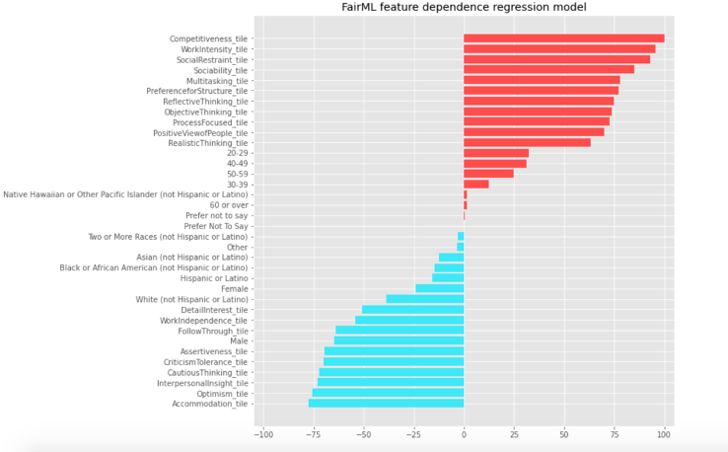
Packages- FairML
the model indeed depends on age, gender and ethics but in a relatively
small proportion.
The biggest positive one is age 20-29 with 30 and the most negative one is Male.
the chances of bias existing are not very high in the model.
pay attention to gender

Slide 26
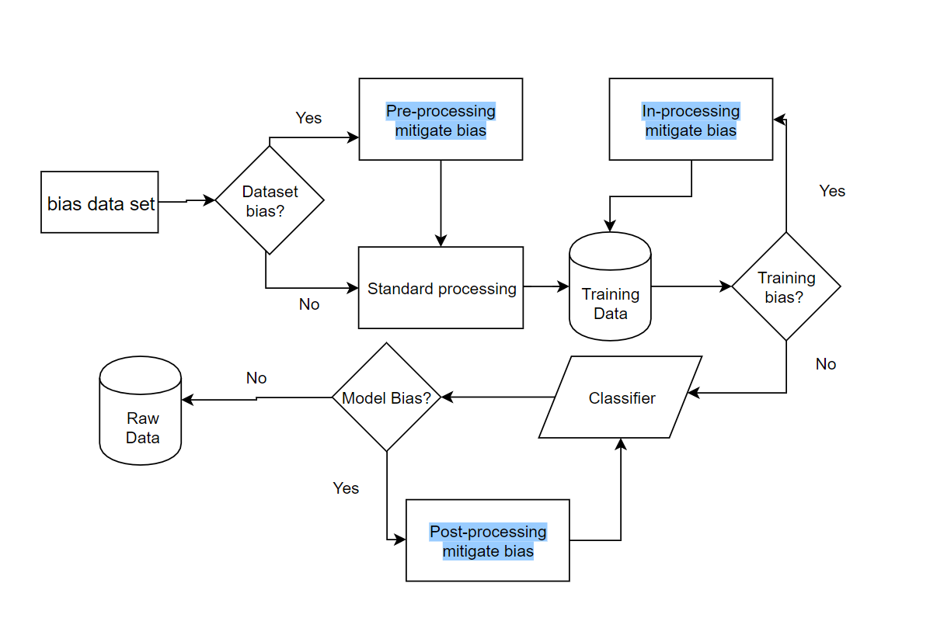
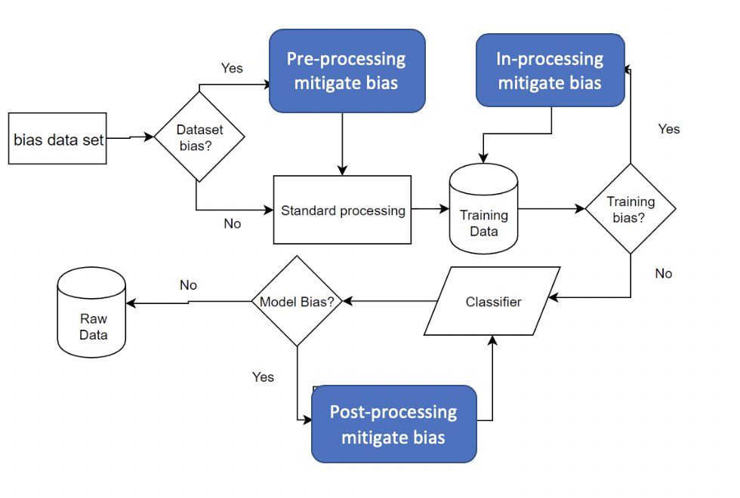
Packages-AI Fairness 360
AI Fairness 360 Detect Bias Pipeline
Notes:
Now we want to introducing the AI FAIRNESS 3 60 package to you, here is the aif 360 detect bias pipeline, as we can see, during the whole modeling process there are three parts we can check the weather the bias exist, pre processing in processing and post processing

Slide 27
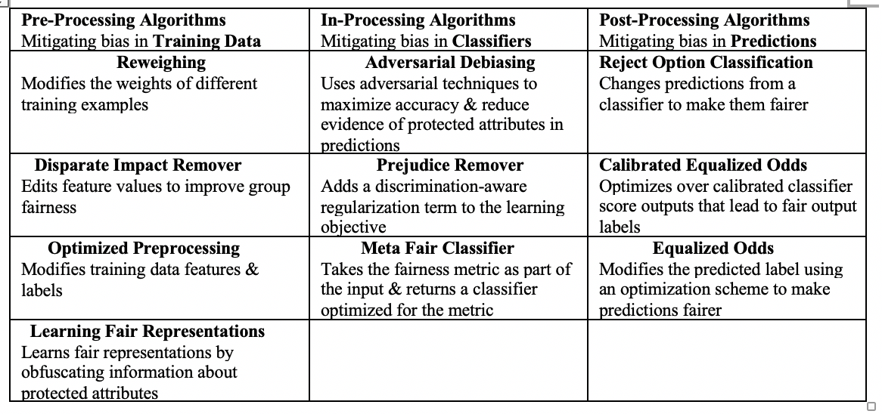
Packages-AI Fairness 360
Metrics And Mitigate Bias Algorithms
Metrics in AI Fairness 360: AI Fairness 360 Open Source Toolkit contains over 70 fairness metrics, the mainstream four metrics are disparate impact, average odds difference, statistical parity difference and equal opportunity difference.
Bias Mitigation Algorithms in AI Fairness 360: AIF 360 currently contains 10 bias mitigation algorithms that span three categories, including pre-processing, in-processing, and post-processing algorithms.
Notes:
There are many metrics and mitigate bias algorithm in this package. In its open soucre toolkit, aif has over 70 fairness metrics the mainstream 5 metrics are disparate impact, average odds difference, statistical parity difference and equal opportunity difference. AIF 360 also contains 10 bias mitigation algorithms that span three categories, including pre-processing, in-processing, and post-processing algorithms.

Slide 28
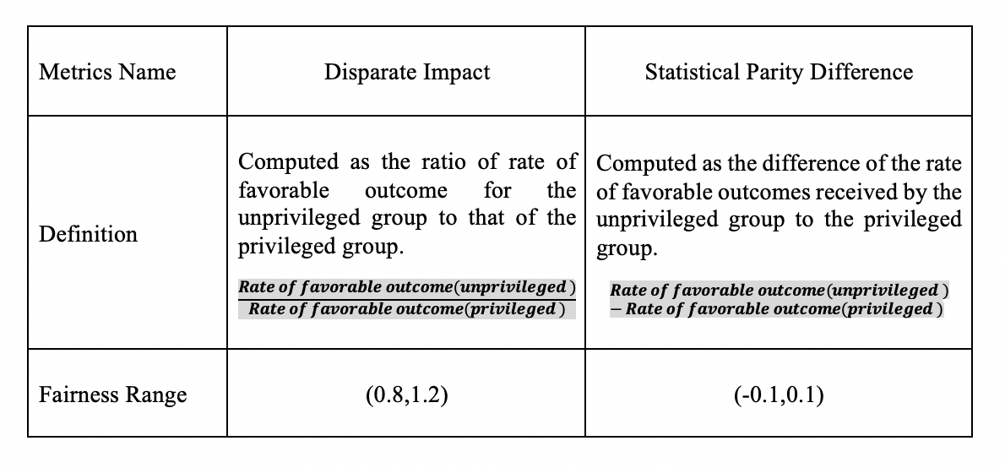
Packages-AI Fairness 360
Metrics
Disparate Impact and Statistical Parity Difference
Notes:
Here is the definition of the disparate impact and statistical parity difference

Slide 29
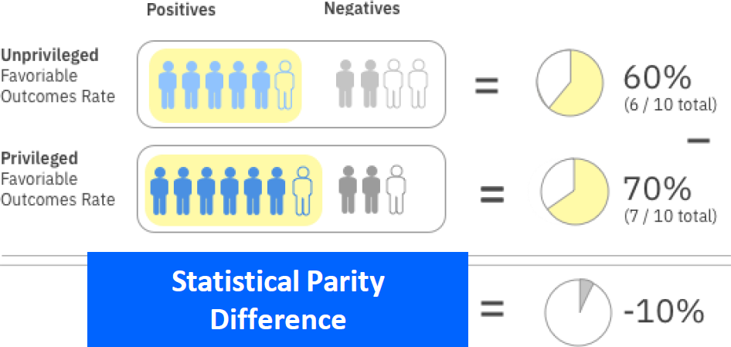
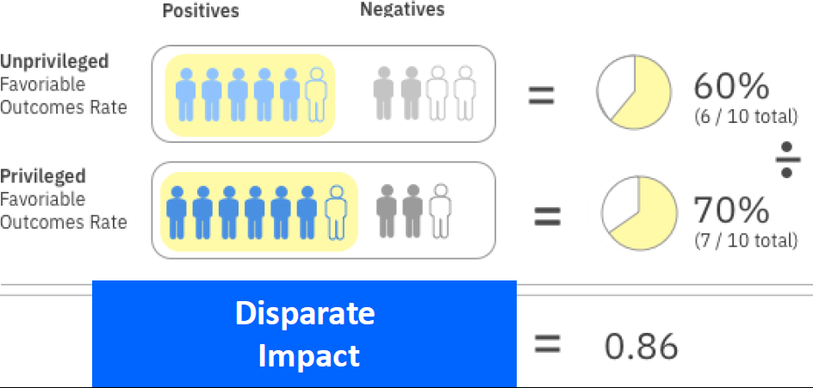
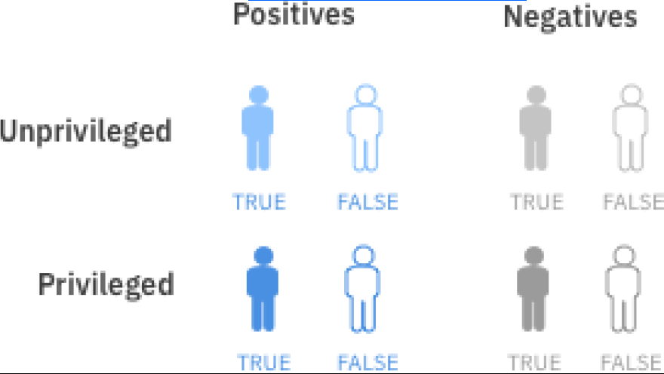
Packages-AI Fairness 360
Metrics
Here are graphs shows how to calculate Disparate Impact and Statistical Parity Difference
All graphs are from IBM's Data Science Community Webinar
Notes:
For your convinience, please allow us to use graph to explain these two metircs. The unprivileged group is the one we want to protect for example female and the privileged group is the mainstream group for example male. These two metrics are just different interpretations of the same data. And we will apply these two metrics into our dataset

Slide 30
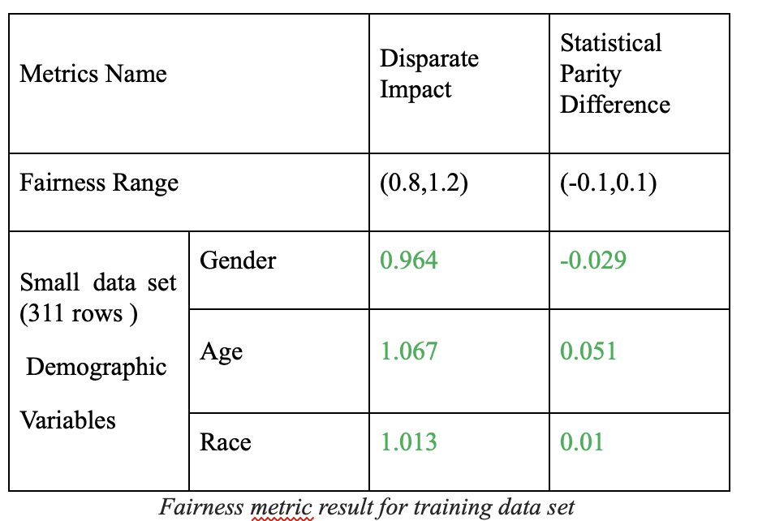
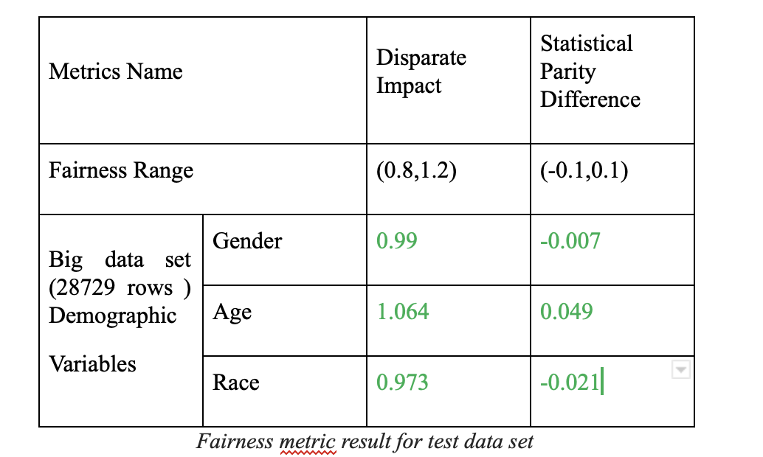
Packages-AI Fairness 360
Bias Check Results
The value of both disparate impact and statistical parity difference for training and test data set are in the range of the fairness
Notes:
The value of both disparate impact and statistical parity difference for training and test data set are in the range of the fairness and we marked the reasonable bias in green font. For example, the left table shows that in a small data set. We choose gender as the test variable and the male is the privileged group, the female is unprivileged group. Then we calculate each metrics for this group and got zero point nine six four and minus zero point zero two nine.

Slide 31
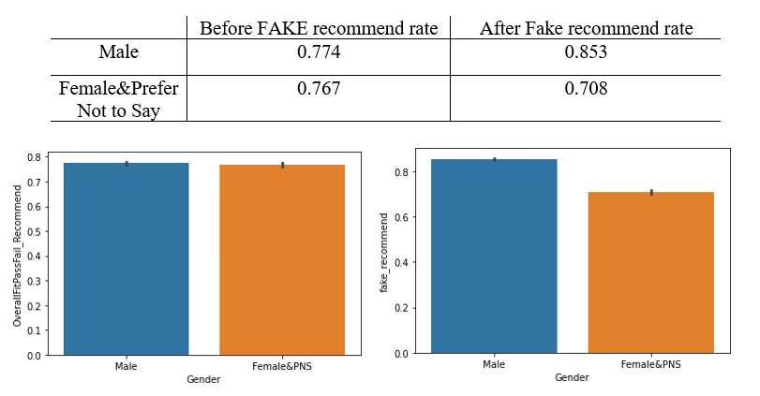
Packages-AI Fairness 360
What If… Fake Data And Bias Mitigation
From the result we have no bias in our data set, but what if future data bring bias? How can we mitigate it?
Notes:
In previous slides We have proved that we don't have bias in our dataset. But what if the future data bring bias into our model. So we made a faked data set and continue to check How can we mitigate the bias. So we increase the males recommend rate and decrease the female recommend rate in our fake data set. Just as the graph shows the left one is before fake the right one is after fake

Slide 32
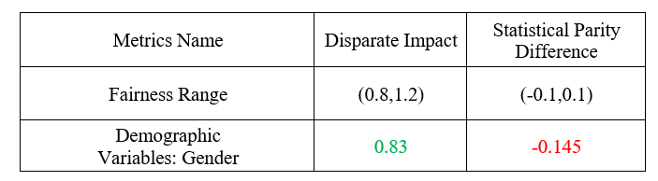
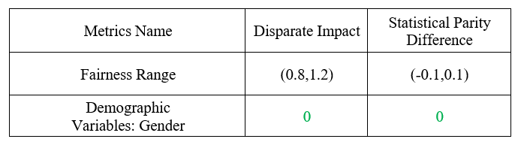
Packages-AI Fairness 360
What If… Fake Data And Bias Mitigation
Check the fake data’s metric, we observed bias out of fairness range:
After we use reweighting algorithm, we mitigate all the bias.
Notes:
Here is the result of fake data. these two table shows how the bias mitigation algorithm works.The above table shows that there exist bias out of fairness range in our fake data.The below table shows that after we use to mitigate bias algorithm,This algorithm is what we just mentioned before in the pre processing,its name is reweighting algorithm,it modified weights of different training examples. And we can see we mitigate all the bias as the two metrics .

Slide 33
Other General Ways
Choose the right learning model for the problem: Instead of using a simple linear regression model, use more complicated matrices, algorithms or models.
Choose the right representative train dataset: Make sure that the parameters or variables are reliable and persuasive. Polish the online questionnaire and generate various percentile questions.
Monitor model performance using real data: Use new and realistic data set to retrain the model periodically. Check the fairness of the model in fixed time.
Remove variables that may generate problems: If there’s truly bias in the model, just delete those data to prevent problems.

Slide 34
Conclusion & Future Work
Conclusion
Recommendation rates for different groups vary to some degree. There is bias when measured by Equalized Odds but not by Four-Fifth rule.
Some python packages, such as AI Fairness 360, FairML, and Fairlearn, are able to detect and address the bias.
We find some common practices to eliminate discrimination, which provides a good reference when we encounter other related fairness problems.
Future work
Find a more complicated model or use a bigger train data set to improve the prediction.
Apply the python package on real-world data, and get a more explicit result about how it impacts the recommendation after eliminate bias.

Slide 35
Thank You

Slide 36

Questions

